Slide 1
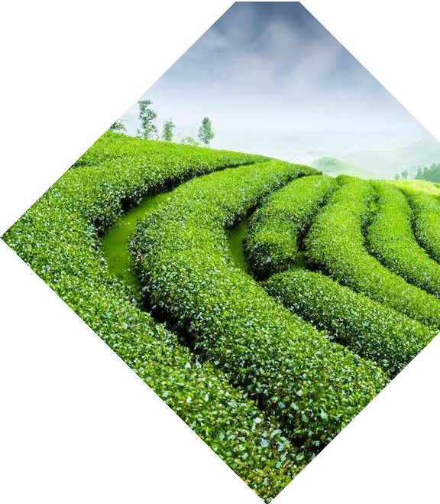
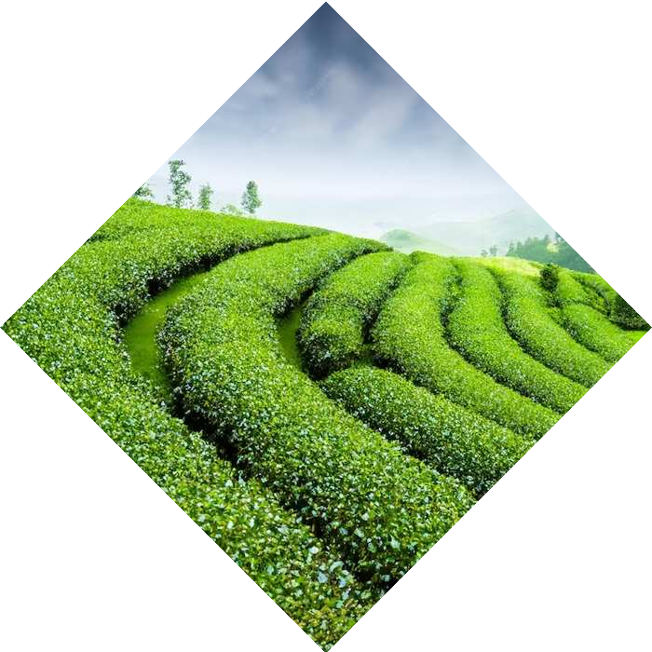
Tea Crop Forecasting: Blending Nature's Wisdom with AI Ingenuity
Moinul Hossain Bhuiyan 20301002

Slide 2
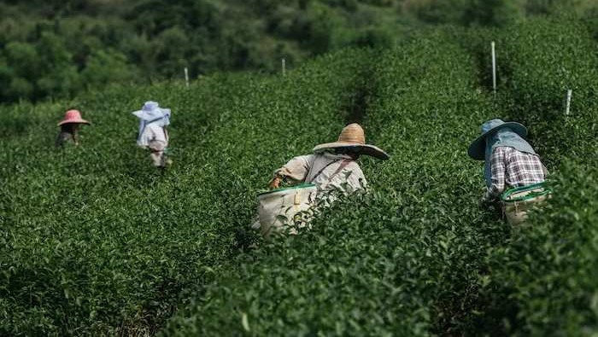
Abstract
This research study compares methods for tea yield prediction using the Food and Agriculture Organization's AquaCrop simulation model and machine learning techniques. Using weather, soil, crop, and agro-management data from 2016 to 2019, the machine learning regression algorithm performed better in yield prediction using fewer data than the simulation model.

Slide 3

Scenario
Pakistan's agricultural sector is crucial for its economy, as it imports various products, including tea. The country's tea production has increased annually, with black tea production increasing by 3.0% and green tea by 5.4%. Pakistan is the second-largest tea importer globally, causing a significant import bill. To address this issue, the National Tea Research Institute was established in 1986, establishing a tea garden and a tea-processing unit.

Slide 4

1. How to calibrate the selected CSM? 2. How do ML regression algorithms perform for tea yield prediction? 3. Which technique from both ML and CSM performs better for tea yield prediction?
GOALS
This study uses machine learning techniques and crop simulation models to predict tea yield in Pakistan using weather, crop, soil, and agro-management data. The AquaCrop simulation model, which requires fewer parameters, was validated and used to improve tea yield prediction. This approach combines multiple data sources to provide a forecast before plucking leaves. This study presents a new paradigm for predicting tea yield in various regions using CSMs, addressing specific research questions.
Machine learning and CSMs are used to predict annual crop yields, but no significant work is done for perennial crops like trees, requiring further research.

Slide 5


Existing Methods
Crop yield estimation is crucial for food security and improving management practices. Various methods, including traditional regression, machine learning, and crop growth models, have been developed to provide reliable information about crop production for decision-making and sustainability. Simulation models have been compared to DM techniques for predicting sugarcane yield, with DM techniques being better. Machine learning (ML) techniques are useful for crop estimation and classification, with applications in corn yield prediction, frost damage prediction, and tea yield forecasting. Deep learning (DL) is an advanced approach used for predicting crop yields, using data from various sources like climate, soil, crop, and satellite. ML and DL techniques have been used to predict crop yields, with ANN models outperforming other methods. Climate change has been studied for its impact on tea yield, with monsoon periods resulting in higher yields but lower quality.

Slide 6
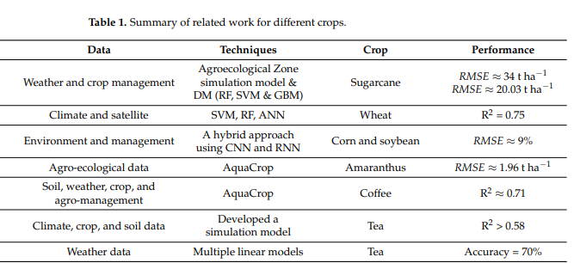
Existing Methods (contd.)
To estimate tea yield, tea growth was simulated using data from tea cultivar TRI 2025 in Sri Lanka. They developed and calibrated a simulation model using climate, soil, and crop data collected from different climatic areas. This model simulated shoot growth, leaf area of the shoot, shoot replacement cycle, dry matter partitioning, and yield. A summary of some of the above-cited work is shown in Table 1.

Slide 7
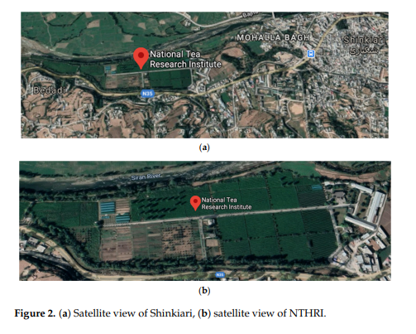
Existing Methods (contd.)
We have conducted this study in Pakistan, where tea is grown. These tea fields are located at an altitude of 1000 m from the sea level and located at 34◦2800” N, 73◦16060” E in Pakhal valley Shinkiari, Mansehra, Pakistan, as shown in Figure 2a,b. The total area of the fields amounts to approximately 30 acres. This tea garden has an equipped soil laboratory and a black and green tea processing unit

Slide 8
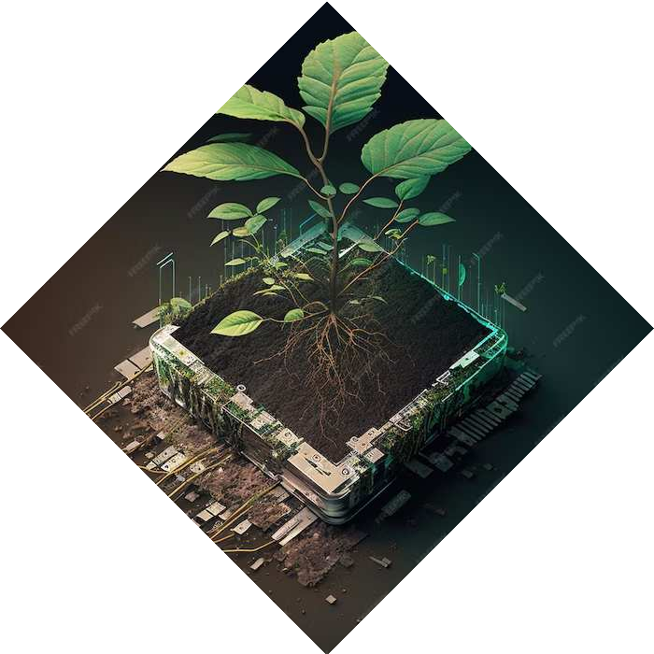
DATA
Data on weather, soil, crop, agro-management, and plucking were collected from NTHRI tea fields from 2009 to 2019. The data was used to estimate tea yield using the AquaCrop simulation model and ML techniques. We processed 239 raw data samples, mapped meteorological data, prepared four datasets for the CSM, and calibrated our AquaCrop model using weather, crop, soil, and agro-management data.

Slide 9
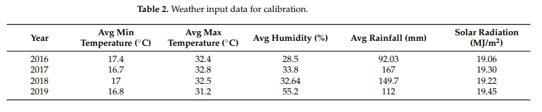
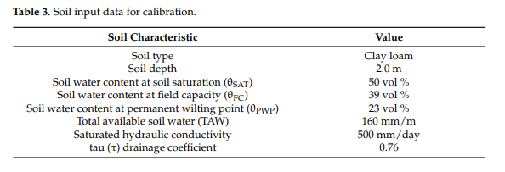
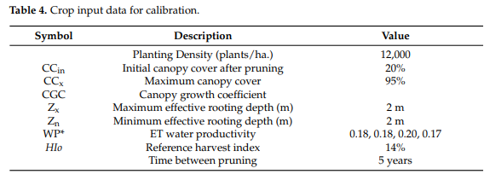
DATA CONTD.

Slide 10

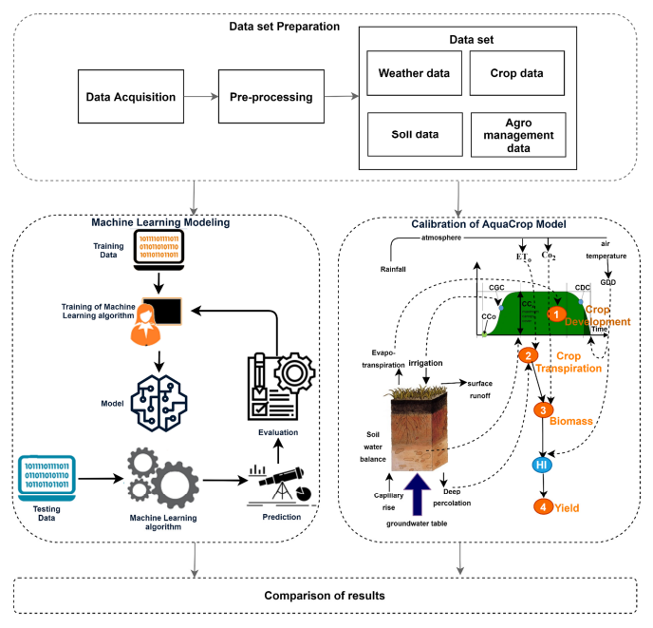

Data Preparation

Slide 11
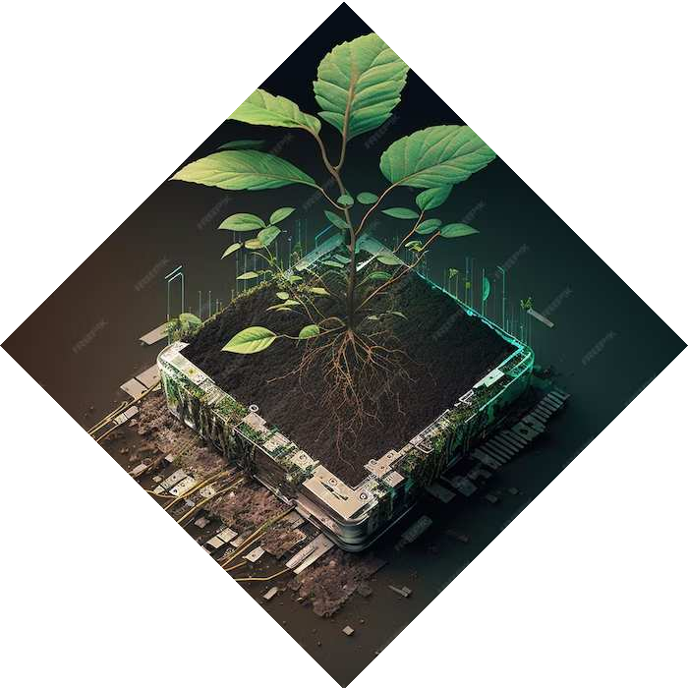
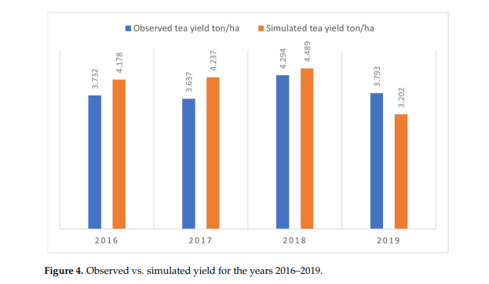
Results
The AquaCrop model was evaluated using MAE, MSE error, and RMSE statistical parameters. Calibration and validation involved adjusting parameters related to canopy cover, crop transpiration, biomass, and yield. The model's performance was evaluated using data from the 2016-2017 growing season, resulting in the best estimates for CC, ETa, and biomass.

Slide 12
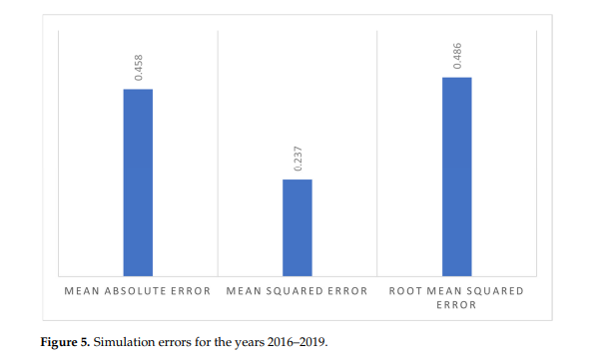
Results Contd
The AquaCrop model's yield values align with observed yields, but in 2019 they were less due to inconsistent tea leaf plucking. Improving data collection strategies and addressing data requirements for crop model calibration can improve results. Simulation yields are significantly correlated with observed yields.

Slide 13
Results Contd
The AquaCrop model's yield values align with observed yields, but in 2019 they were less due to inconsistent tea leaf plucking. Improving data collection strategies and addressing data requirements for crop model calibration can improve results. Simulation yields are significantly correlated with observed yields.

Slide 14
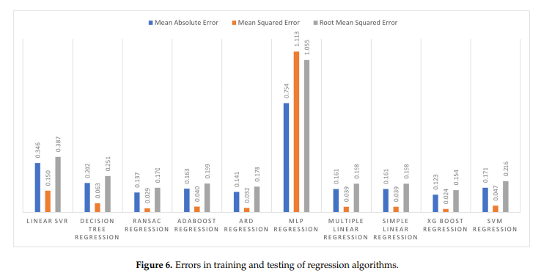
Results Contd
XGBoost outperformed other MLR models in predicting yield with minimal error, with an average mean annual error (MAE) of 0.123 t/ha over 2016-2019.

Slide 15
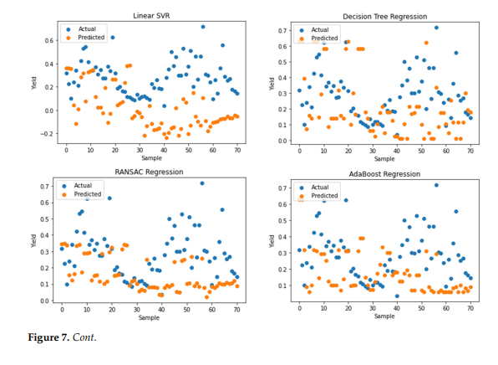
Results Contd
The study presents scatter plots illustrating the actual and predicted yields of regression algorithms, highlighting errors in training and testing.

Slide 16

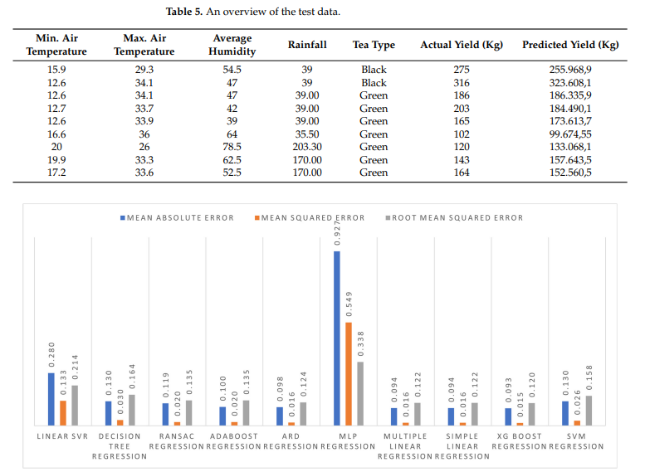
Regression
The study compared ML and AquaCrop models for tea yield prediction, finding that XGBoost performed best with a MAE of 0.093 t/ha and an MSE of 0.015 t/ha, and a RMSE of 0.120 t/ha.

Slide 17
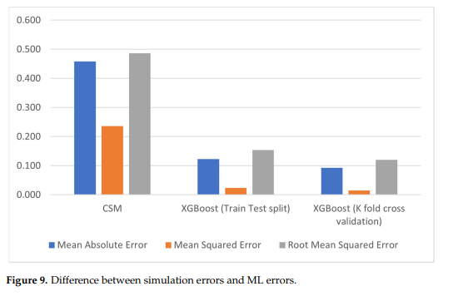

Regression Algorithm

Slide 18

Answering Questions
To answer the first question: The AquaCrop simulation model was calibrated for tea yield prediction using weather, crop, soil, and agro-management data, demonstrating a close relationship between simulated and observed yield values.
To Answer the second question: Ten ML regression algorithms were implemented for tea yield prediction, utilizing MAE, MSE, and RMSE techniques to measure error in observed and predicted yield.
To answer the final and third question: ML techniques with 10-fold cross-validation perform better for tea yield prediction, while simulation models require complex parameters for accurate calibration due to data quality issues.

Slide 19

Comparison
In comparison to this, ML techniques do not require all these parameters. They can provide good results with a few parameters: temperature, rainfall, humidity, pH, sunshine, etc. If data are available for all parameters, CSMs can be useful for performing and simulating those experiments, which are very expensive and time-consuming. This study is an important contribution to the use of CSMs for perennial crops and specifically tea crops. It also provides a way to predict tea yield in Pakistan and other areas of the world. It will help increase tea production in Pakistan and other regions by helping to improve management practices using simulation models. These models can provide predictions in different climatic scenarios and environmental conditions.

Slide 20
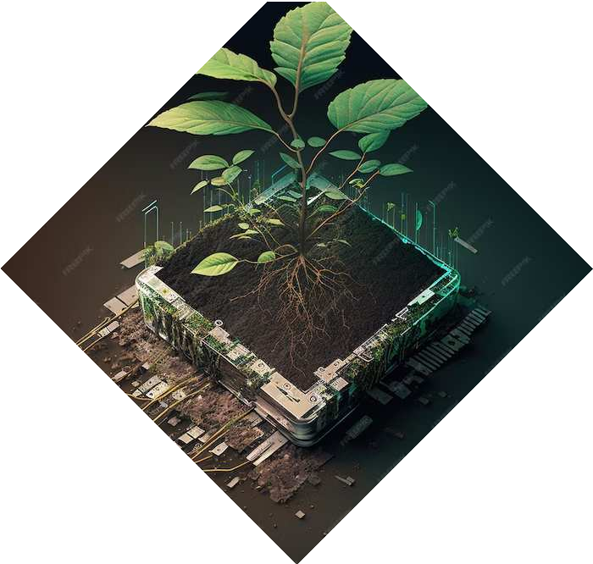
Conclusion
This research study acquired data from NTHRI and extracted data from four databases, including weather, crop, soil, and agro-management data. We have selected and calibrated the AquaCrop simulation model for tea yield prediction because it requires fewer parameters than the other simulation models. The AquaCrop model was calibrated using data associated with weather parameters, crop, and soil characteristics to estimate tea crop production. We have trained ML models using this data and observed that the XGBoost regressor outperformed all the other models. We concluded that ML techniques perform better than simulation models by comparing the results of both simulation models and ML techniques. We also concluded that simulation models could be best suited for the estimation of the output of those very expensive and time-consuming experiments if enough input parameters are available. For future studies associated with AquaCrop calibration, it is suggested to use all model variables to perform regression analysis. The results can be further improved by recording more detailed information related to crop and field experiments.

Slide 21
Embracing the Future of Tea
Blend the richness of nature's wisdom with AI's ingenuity. Let's shape a sustainable future for tea crop forecasting!

Slide 22
Thanks!
Do you have any questions?
moinul.hossain.Bhuiyan@g.bracu.ac.bd

